Slide 1

CAPSTONE PROJECT
AI-Powered Student Performance Workflow
Presented By
Student Name: RISHIT GHOSH
College Name: GEETHANJALI COLLEGE OF ENGINEERING AND TECHNOLOGY
Department: CSE – AI&ML
Email ID: rishitghosh06@gmail.com

Slide 2
OUTLINE:
Problem Statement (Should not include solution)
Proposed System/Solution
System Development Approach (Technology Used)
Algorithm & Deployment
Result (Output Image)
Conclusion
Future Scope
References

Slide 3
Problem Statement:
Generally used, student performance evaluation is mostly rule-based (pass/fail decided by marks threshold).
This approach:
Does not account for predictive insights
Lacks automation in reporting
Provides limited comparative analysis
Challenge: Can we build a workflow that predicts student outcomes using AI/ML and integrates them into a dashboard for analysis?

Slide 4
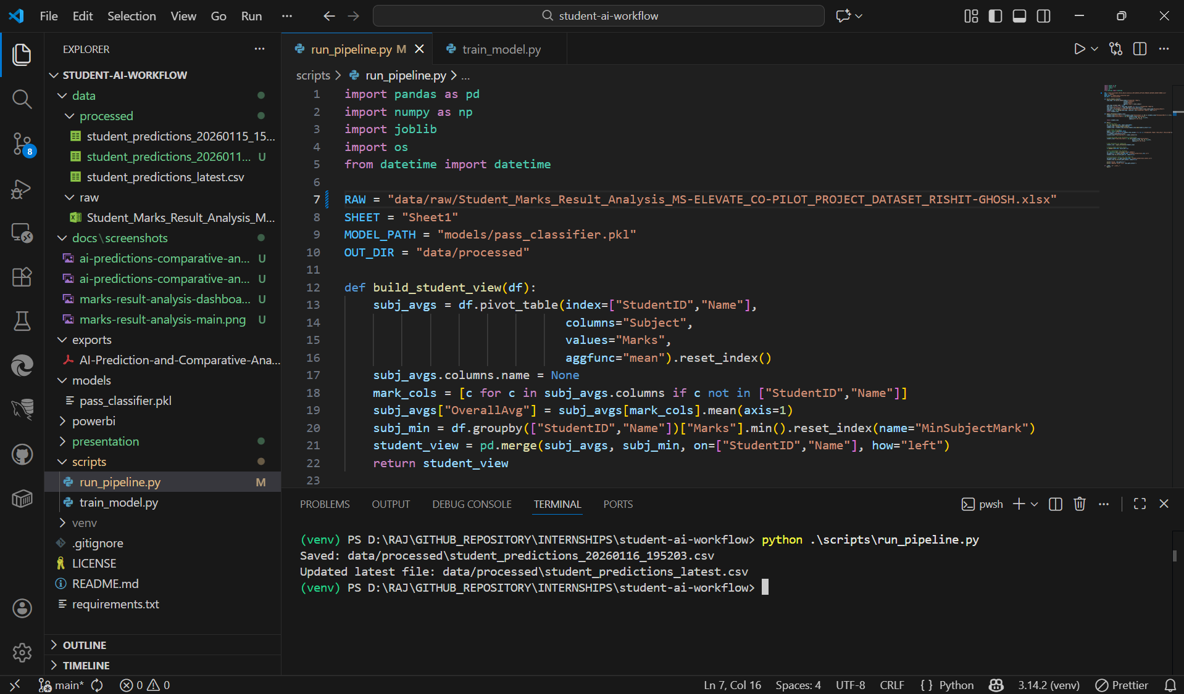
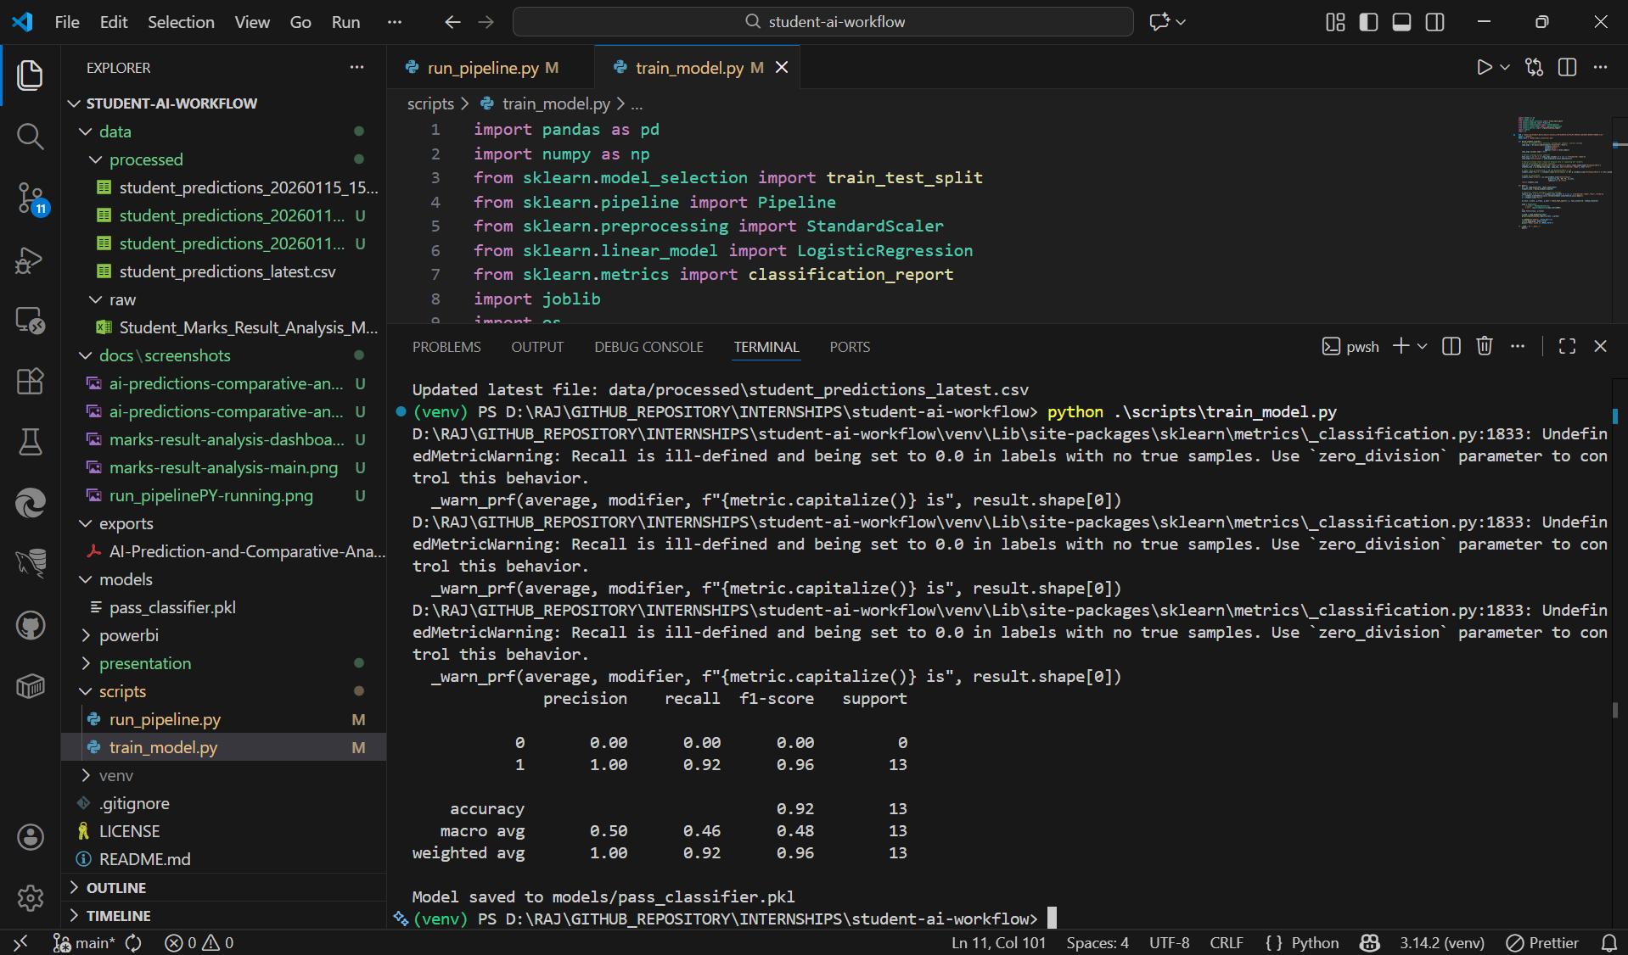
Proposed Solution:
Python ML Pipeline
Build predictive models to forecast pass/fail outcomes and grade distributions
Enable data-driven insights beyond static thresholds
Power BI Dashboard
Compare rule-based vs AI-driven predictions
Provide interactive visualizations for deeper analysis
Copilot Integration
Support in workflow design
Assist with repository organization and documentation
Enhance collaboration and productivity
Future Extension: Power Automate
Automate scheduled data refreshes
Streamline report distribution to stakeholders

Slide 5




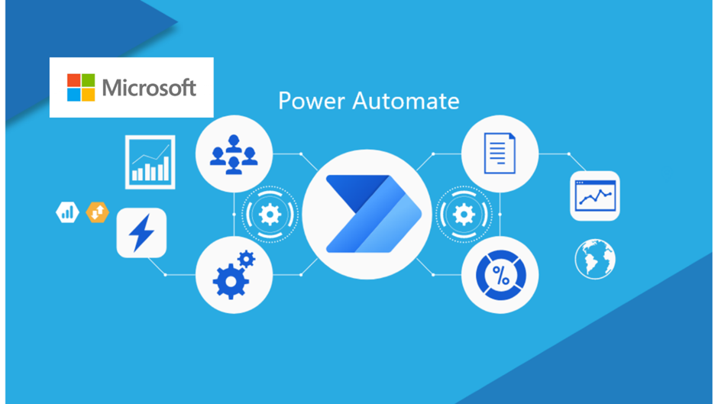
System Approach:
System Requirements:
Python 3.11 → Used for data preprocessing, model training, and prediction pipeline.
Power BI Desktop → Used for visualization of both rule‑based and AI‑based results.
Libraries Used:
pandas → Data cleaning, preprocessing, and tabular manipulation.
scikit‑learn → Training the ML classifier (Logistic Regression) and generating predictions.
joblib → Saving and loading the trained model (pass_classifier.pkl) for reuse.
openpyxl → Reading/writing Excel files for raw student marks dataset.
Workflow Structure:
Raw Data (Excel[.xlsx])
Student marks dataset collected in .xlsx format.
Stored in data/raw/.
Processed Predictions (CSV)
Data cleaned and passed through ML pipeline.
Predictions (pass/fail, grade) exported to data/processed/student_predictions_latest.csv.
Trained Model (PKL)
Logistic Regression model trained on historical marks.
Saved as models/pass_classifier.pkl for reproducibility.
Dashboard Visualization (PBIX)
Power BI dashboard integrates both rule‑based and AI predictions.
Two pages:
Marks & Result Analysis (rule‑based)
AI Predictions & Comparative Analysis (ML‑based)
Final Flow:
Raw Data → Preprocessing → ML Model Training → Predictions Export → Power BI Dashboard Visualization

Slide 6
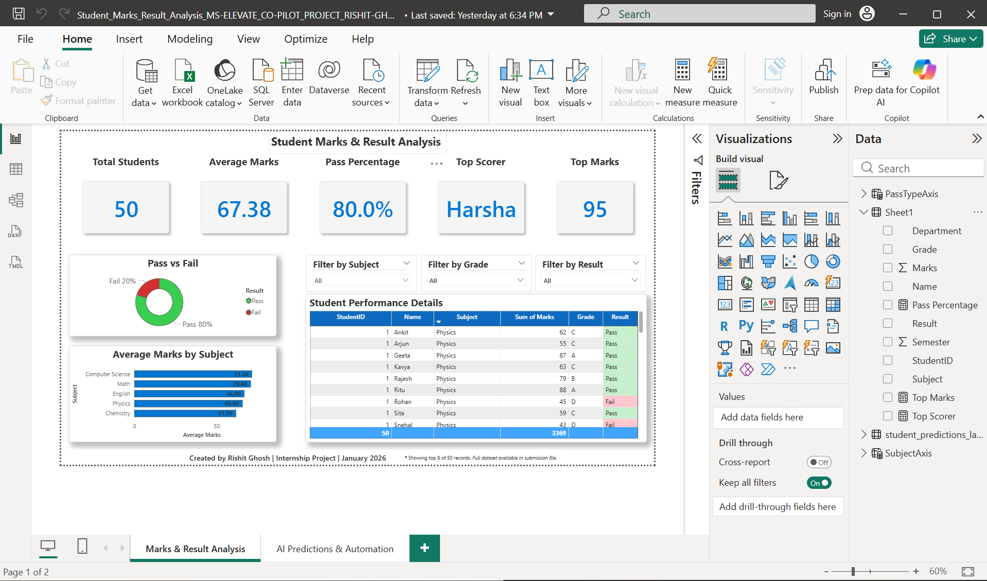
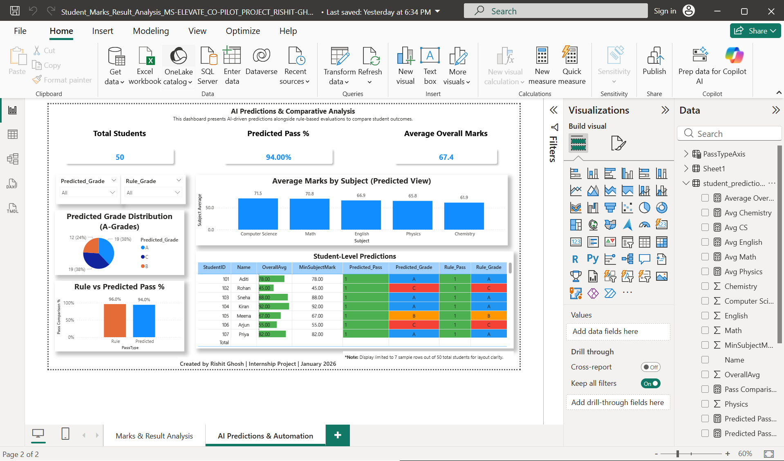
Algorithm & Deployment:
Algorithm Selection:
The project uses a Logistic Regression classifier.
This algorithm was chosen because it is simple, interpretable, and effective for binary classification tasks such as predicting whether a student will pass (1) or fail (0).
Logistic Regression also provides probability scores, which can be useful for understanding confidence in predictions.
Data Input:
The input dataset consists of student marks stored in Excel format.
Each record includes subject-wise marks and a rule-based pass/fail outcome.
This dataset forms the basis for training and testing the machine learning model.
Training Process:
Preprocessing → Clean the dataset, handle missing values, and prepare features.
Model Training → Apply Logistic Regression using scikit-learn.
Model Saving → Export the trained model as pass_classifier.pkl using joblib.
This ensures reproducibility and allows the model to be reused without retraining.
Prediction Process:
Pipeline Execution → Run run_pipeline.py to load the saved model.
Generate Predictions → Predict pass/fail outcomes and assign grades (A/B/C).
Export Results → Save predictions into student_predictions_latest.csv.
Integration → Load the CSV into Power BI for visualization and comparative analysis.
Deployment:
The Power BI dashboard is refreshed with the latest predictions.
Two pages are maintained:
Marks & Result Analysis → Rule-based evaluation.
AI Predictions & Comparative Analysis → ML-driven outcomes.
This deployment ensures that both traditional and AI-based insights are available in a single, interactive interface.

Slide 7
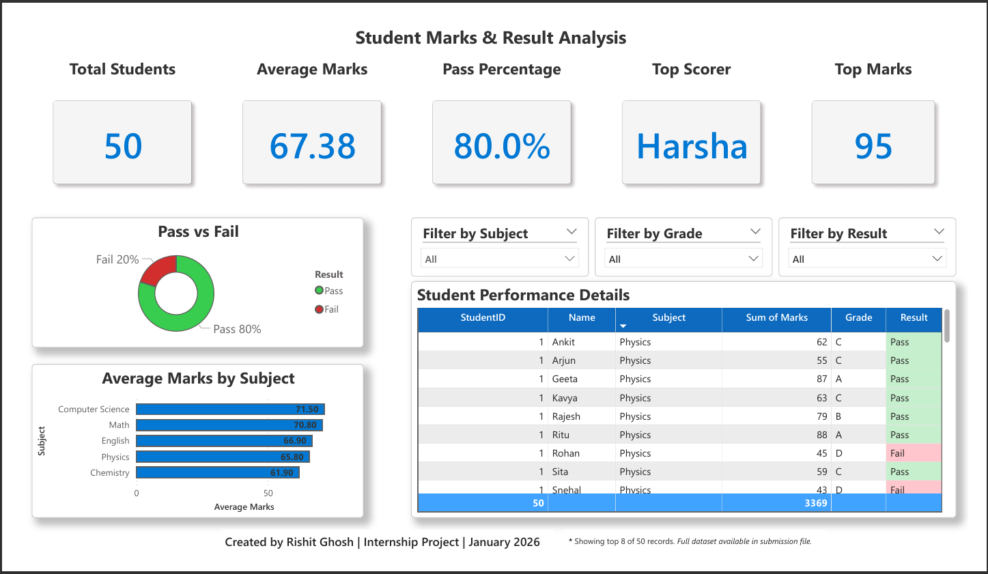
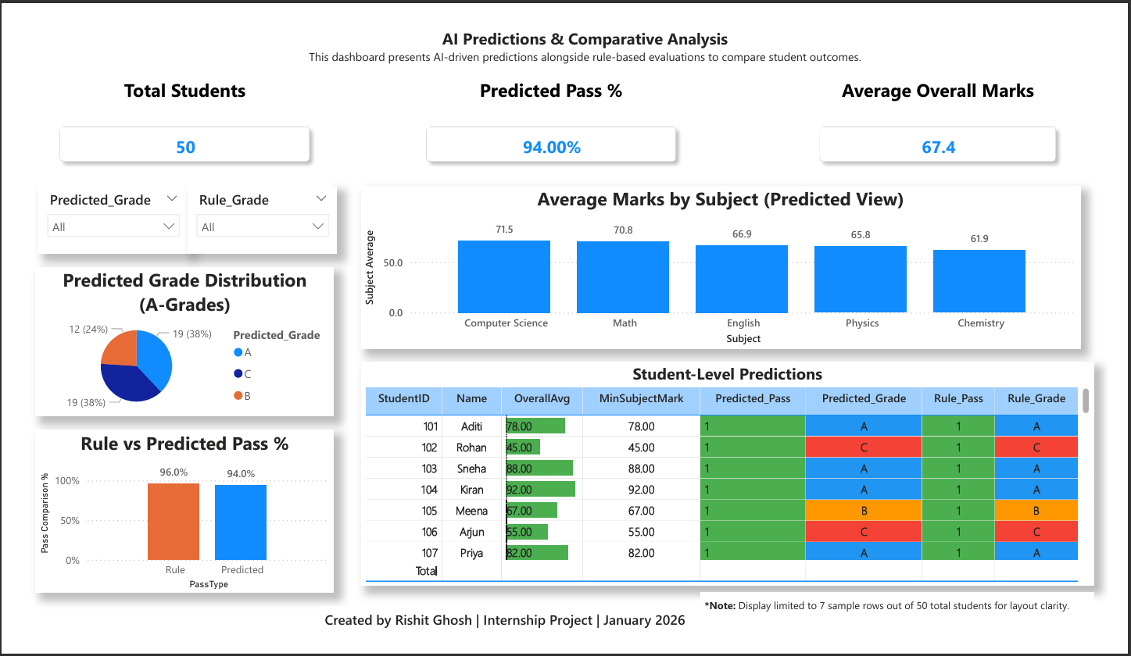
Result:
The dashboards clearly show rule‑based vs AI‑predicted outcomes with KPIs, charts, and student‑level tables. Comparative analysis highlights how the ML model aligns with traditional evaluation while adding predictive insights.
Marks & Result Analysis (Rule-based)
AI Predictions & Comparative Analysis

Slide 8
Conclusion:
Designed and implemented a modular workflow for student performance analysis using Python and Power BI.
Built a Logistic Regression model to predict pass/fail outcomes and grades from student marks.
Developed dashboards that provide comparative insights between rule‑based evaluation and AI predictions.
Ensured the workflow is reproducible, well‑structured, and ready for extension with automation or advanced models.

Slide 9
Future scope:
Power Automate Integration → Automate report generation and scheduled dashboard refresh, reducing manual effort.
Dataset Expansion → Include additional features such as attendance, assignments, and demographics to improve prediction accuracy.
Advanced ML Models → Experiment with Random Forest, XGBoost, or ensemble methods for higher performance and deeper insights.
Online Deployment → Publish dashboards via Power BI Service for accessibility across devices and real-time collaboration.
Copilot Studio Integration → Build AI agents that can answer queries, provide insights, and interact with the dashboard dynamically.

Slide 10
References:
scikit-learn Documentation -> https://scikit-learn.org/stable/index.html
Power BI Official Docs (Microsoft Learn) → https://learn.microsoft.com/en-us/power-bi/
Microsoft Copilot Resources:
Copilot Success Kit: https://adoption.microsoft.com/en-us/copilot/success-kit/
Copilot Studio Resources: https://microsoft.github.io/copilot-studio-resources/
Microsoft 365 Copilot Chat: https://copilot.cloud.microsoft/
GitHub Repository -> https://github.com/rajghosh06-dev/student-ai-workflow/

Slide 11
Thank You

